Slide 1






SMART TRAFFIC MANAGEMENT SYSTEM
FOR
URBAN CONGESTION CONTROL
Course - Coordinator : Mrs. Yogita Narule
PBL Evaluator : Mr. Sanjay Patil

Slide 2

Table of contents
01
02
03
04
Problem
Existing solution
Our Idea
Objectives
05
06
07
08
Results & Analysis
Future Scope
Methology
Technology Aspects

Slide 3

PROBLEM:
-: Problem Statement :-
Smart Traffic Management System for Urban Congestion Control.
SIH 25050 - Software edition - Government of Odisha.
Traffic signals often operate on predetermined timings that may not reflect the actual number of vehicles waiting in each lane.
1. Fixed Timers: Traffic lights run on a set countdown, changing colors even if no one is there.
2. Long waiting times: Vehicles wait even when traffic demand differs between lanes.
3. Emergency delays: Congestion can delay emergency vehicles travelling through intersections.
4. Blind System: Because the lights cannot "see" the cars, you often get stuck waiting at a red light while the green light is given to a completely empty road.

Slide 4



EXISTING SOLUTION:
  Fixed-Time Signals:
  Manual Traffic Control:
Limitation : Do not adapt their timing to changing traffic demand.
  Sensor Based Traffic Control :
  Metro City Dynamic Signals:
Limitation : Sensors may provide limited information about vehicle position and movement
Limitation : Requires continuous human monitoring and intervention.(microcontroller based timers).
Limitation : Pune, bengaluru dynamic signal has not considered the type of vehicle

Slide 5

OUR IDEA:
What is Unique/
Innovative?
A SUMO-based traffic system that dynamically adjusts signal timings and prioritizes emergency vehicles using Python and TraCI.
1. Traffic-responsive signals:
Green-light duration changes based on simulated traffic conditions rather than relying only on fixed timings.
3. Timer calculation according to type and count of vehicle:
According to PCU factor given by IRC (Indian road congress)
2. Emergency-vehicle priority:
Includes a rule-based priority mechanism for emergency vehicles in the simulation
4. Testable simulation environment: SUMO and TraCI allow traffic scenarios and signal-control decisions to be tested in a simulated road network.

Slide 6
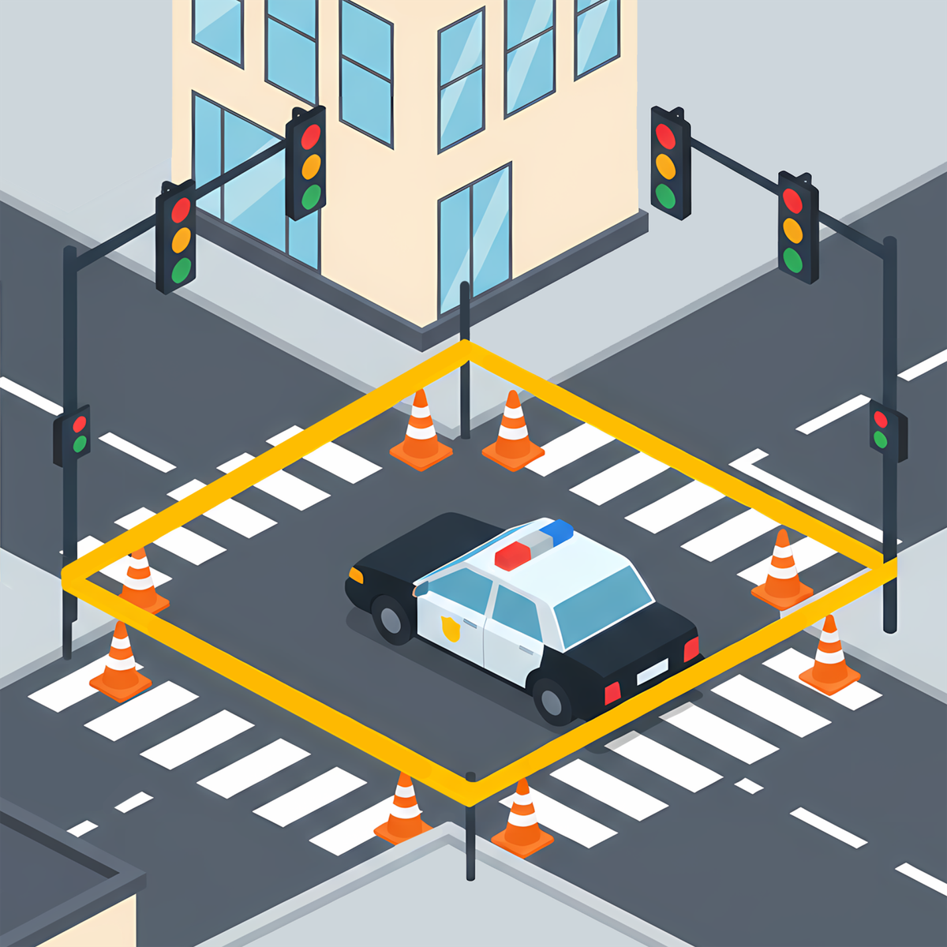

OBJECTIVE:
Develop a rule based logic model to manage congestion
Develop Smart Traffic Signals
Build Traffic Simulation
Give Priority to
Evergency Vehicles
Evaluate System Performance

Slide 7
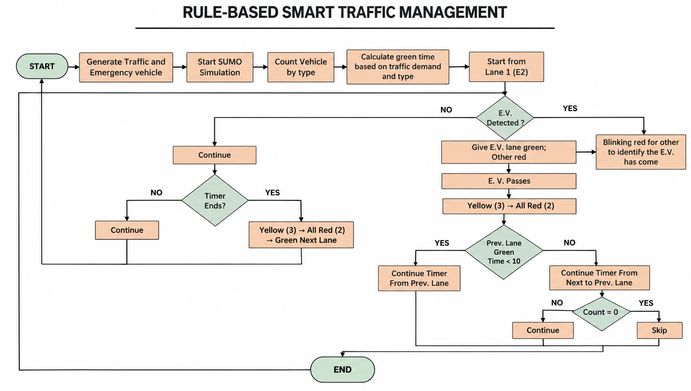
METHODOLOGY:

Slide 8






TECHNOLOGY ASPECTS
SUMO Simulator :
  Free & Open-Source
  Live AI Connection : TraCI connects SUMO with Python.
  Microscopic Simulation : Tracks individual vehicles and their types.
  Easy Road Design : NETEDIT helps create roads, lanes, and intersections easily.
Python :
  Easy to Use: Simple syntax to make rule based logic
  SUMO Integration: TraCI connects Python with SUMO for real-time monitoring and signal control.
Traci:
  Real-Time Communication: TraCI connects SUMO with Python to receive live vehicle data.
  Traffic Signal Control: Allows Python to dynamically control traffic lights.

Slide 9

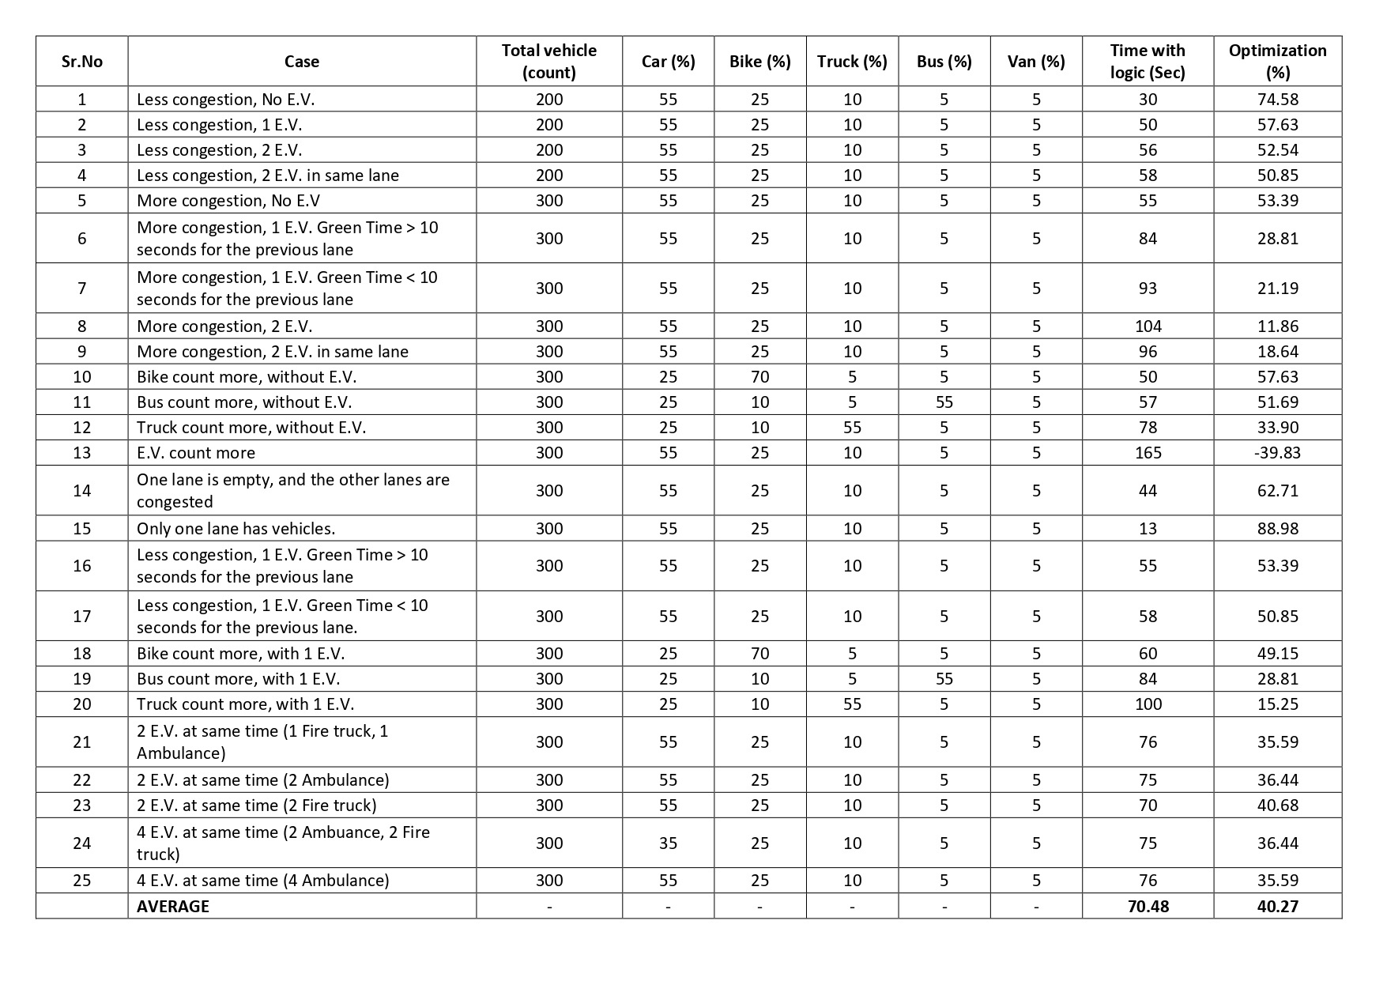

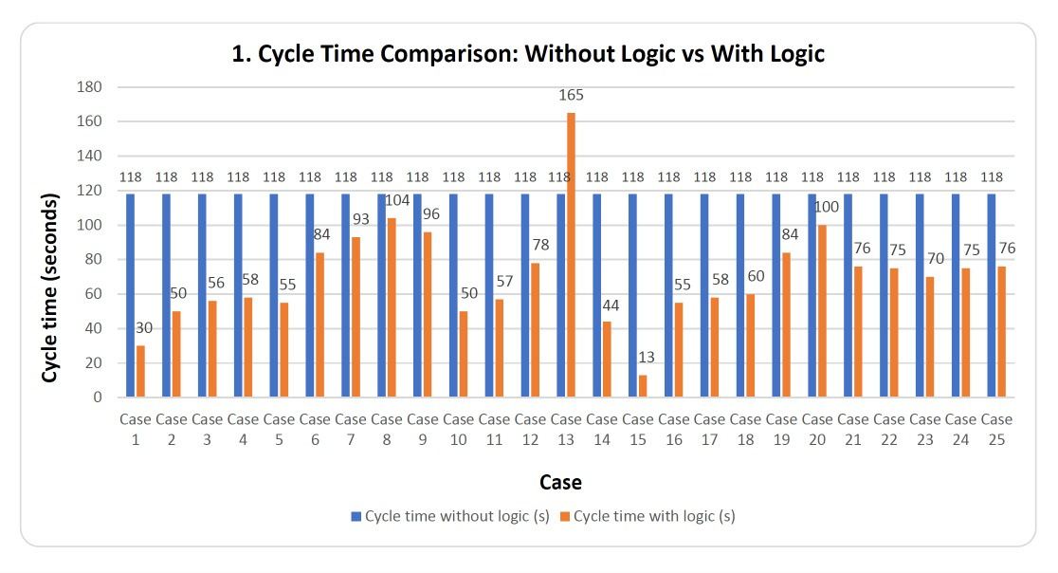

RESULT & ANALYSIS:
Cycle Time Comparison
Observation Table

Slide 10
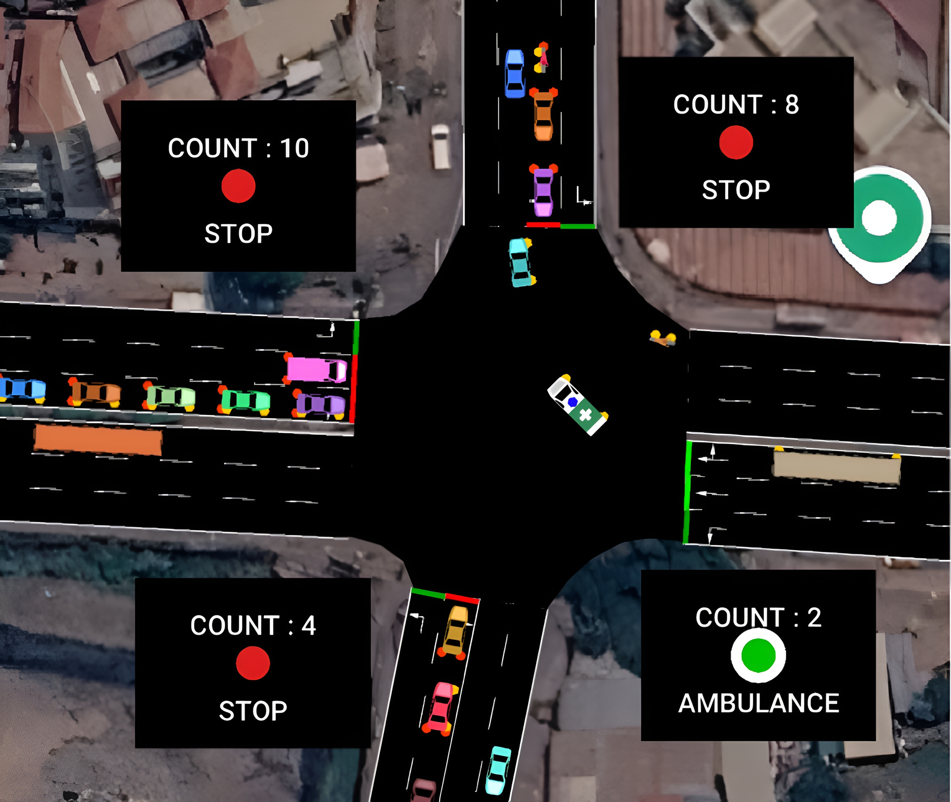
RESULT & ANALYSIS
Fixed Time Control
118 Sec
Average Waiting Time
Dynamic Time Control
70.48 Sec
Average Waiting Time
Optimization
40.27 %
Reduction in Waiting Time

Slide 11

FUTURE SCOPE:
Multiple Junctions Coordinate signals across multiple intersections.
Real-World Testing Implement the system using CCTV cameras and IoT sensors.
YOLO Integration Real-time vehicle detection and counting to calculate signal timers.
AI Prediction
Predict traffic congestion and optimize signal timings.

Slide 12

CONCLUSION:
-: CONCLUSION :-
The Smart Traffic Management System uses SUMO, TraCI, and Python to dynamically adjust traffic signal timings based on vehicle count, vehicle type by rule based control which gives emergency vehicle priority in simulation mode.
Thank You...
Here we are with our full Working Simulation on
Smart Traffic Management !!!
Junction iQ

